Slide 1
Ch.6 Terahertz Spectrometer Calibration
Lee Jong Geon

Slide 2
Contents
Why Calibrate Terahertz Spectrometer?
Frequency Calibration
Amplitude Linearity Calibration
Reflection Standards

Slide 3
Why Calibrate
Terahertz Spectrometer?

Slide 4
1. Why Calibrate Terahertz Spectrometer
Calibration is a procedure for verifying instrumental performances, accuracy and precision.
Disadvantage
The bandwidth is large.
In the terahertz band, few solid materials have narrow resonance absorption lines, and those lines are too few.
Advantage
Calibrating the frequency scale also ensures the correctness of the phase.

Slide 5
Frequency Calibration

Slide 6
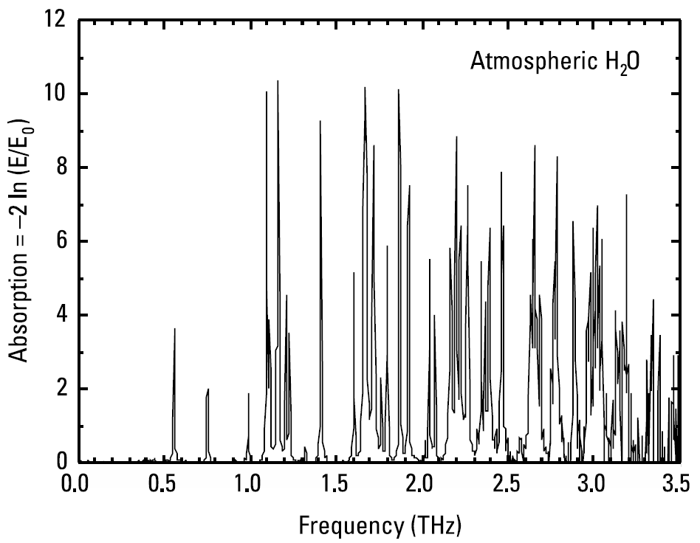
2.1 Gases
The most commonly used means of frequency verification in the terahertz band is atmospheric water vapor.
1.113
1.097
f > 2THz , no usable single lines
1.410
0.557
0.752

Slide 7
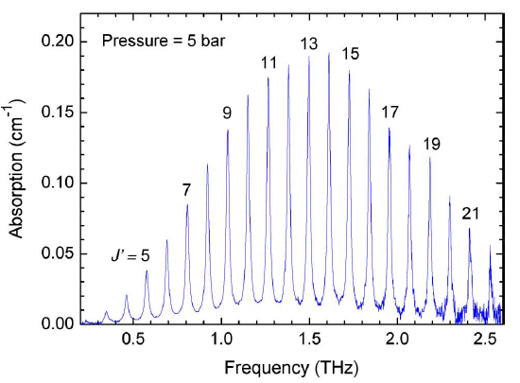
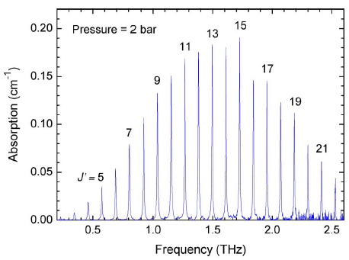
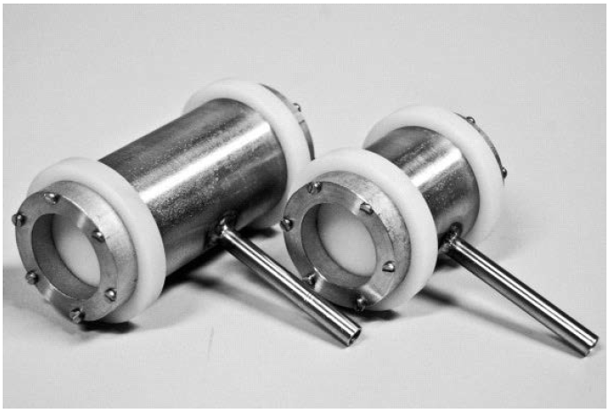
2.1 Gases
Linear gas molecules have pure rotational spectra consisting of a frequency comb of nearly equally spaced lines with a distinctive amplitude envelope.
CO absorption spectra
➔ Must be highly robust and have excellent gas seals.
Aenchbacher, W., M. Naftaly, and R. Dudley, “Line Strengths and Self-Broadening of Pure Rotational Lines of Carbon Monoxide Measured by Terahertz Time-Domain Spectroscopy,” Applied Optics, Vol. 49, No. 13, 2010.

Slide 8
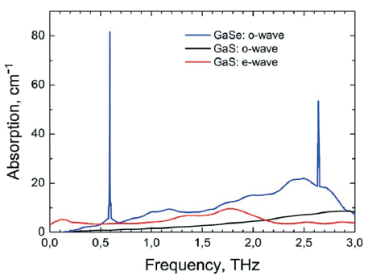
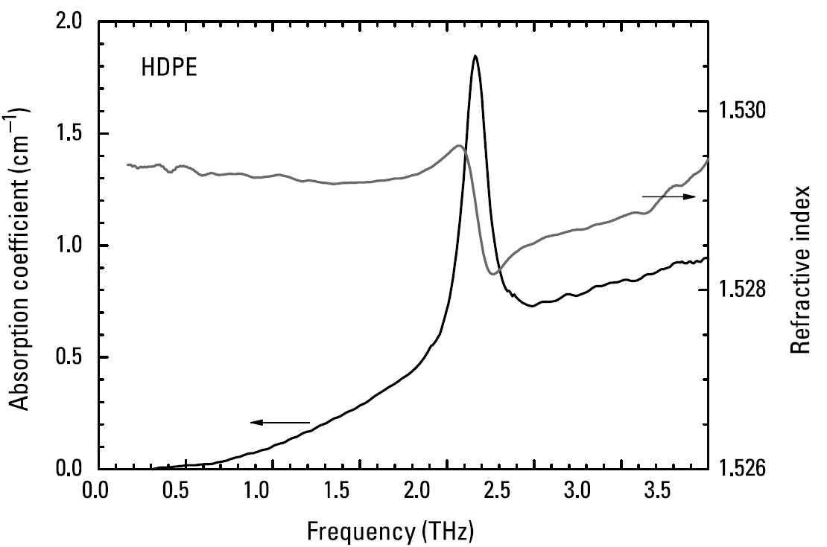
2.2 Solids
For the purpose of frequency calibration, a solid material must have strong and narrow absorption lines.
In contrast to single crystals, polycrysyalline materials have much broader and shallower peaks.
2.17THz
➔ Solid crystalline materials must be judged poorly suited to the purpose.
Molloy, J. F., et al., “Dispersion Properties of GaS Studied by THz-TDS,” Cryst. Eng. Comm., Vol. 16, 2014.

Slide 9
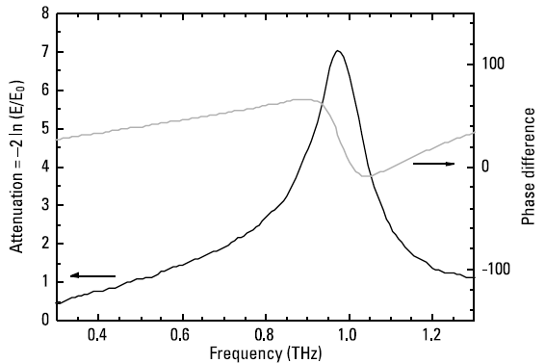
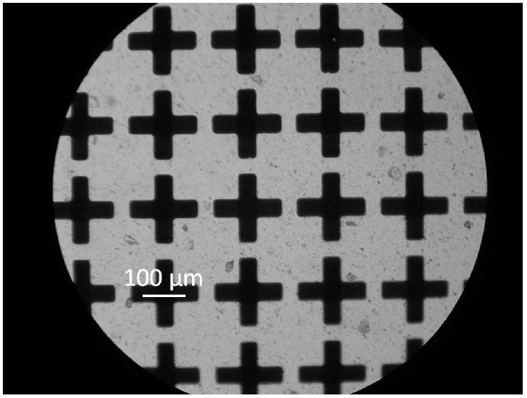
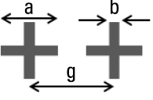

2.3 Resonant Mesh Filters
An important advantage is tha tsuch filters are robust, stable, convenient to use, and can be fabricated as calibration sets offering a number of frequencies over the desired range.
150µm
$$ν_{c}=c/2a$$

Slide 10
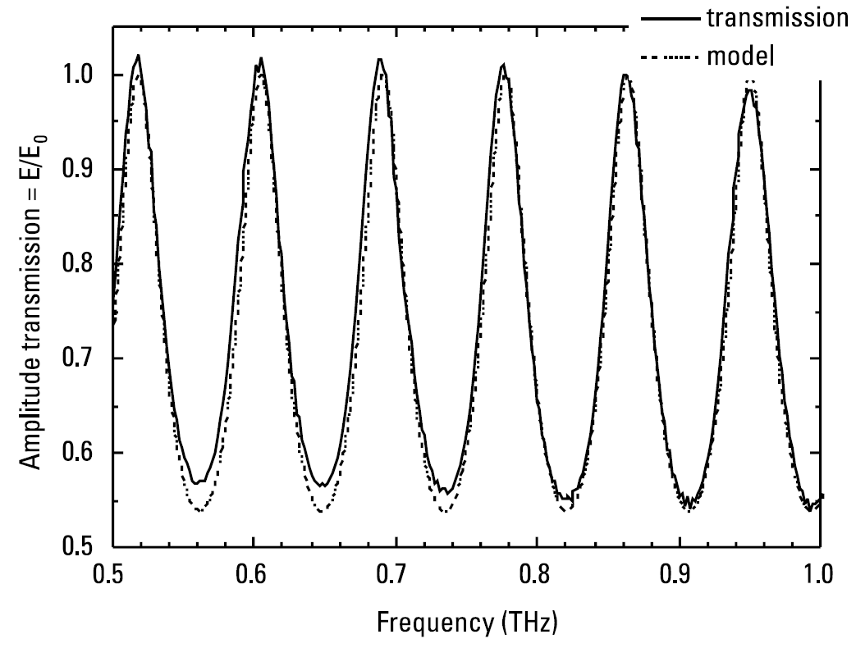
2.4 Etalons
The simplest method of checking the frequency scale of a terahertz spectrometer is to record the frequencies of the peaks and troughs in the transmission spectrum of the etalon and to compare them.

Slide 11
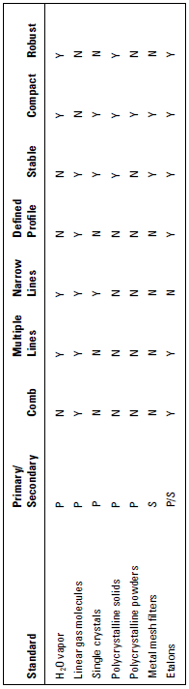
2.5 Summary of Frequency Calibration Standards

Slide 12
Amplitude Linear Calibration

Slide 13
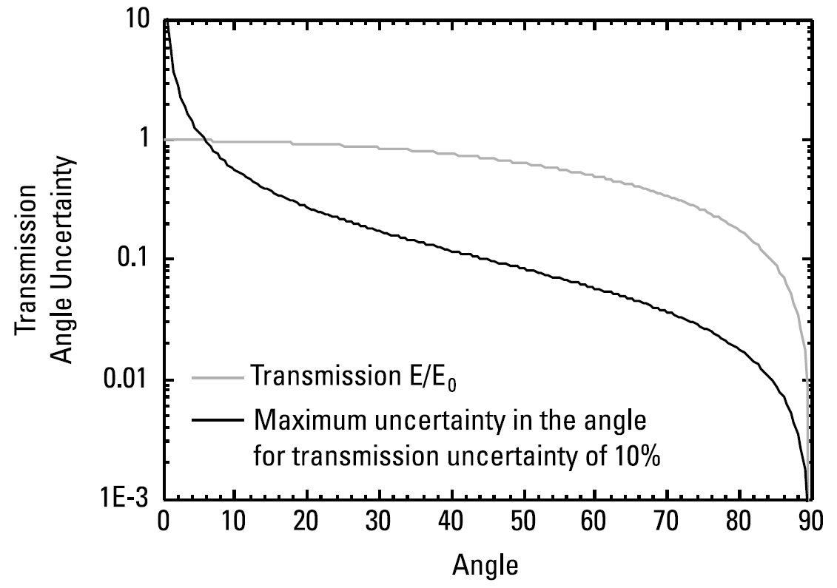



3. Amplitude Linearity Calibration
The analysis and interpretation of terahertz data assumes that the amplitude response of a terahertz system is linear.
$$T=\frac{E}{E_{0}}=\cos{θ}$$
$$∆T≈∆θ\sin{θ}$$
$$∆θ=\frac{∆T}{T}\frac{1}{\tan{θ}}$$

Slide 14
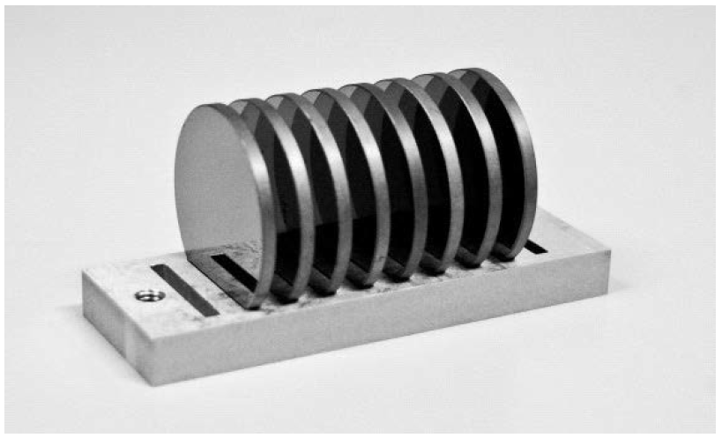

3. Amplitude Linearity Calibration
High-resistivity silicon has negligible absorption and dispersion in the terahertz band.
➔ Transmission loss through a silicon plate is frequency-independent and due solely to Fresnel reflection.
$$T=\frac{E_{N}}{E_{0}}={\left(1−R\right)}^{N}$$

Slide 15
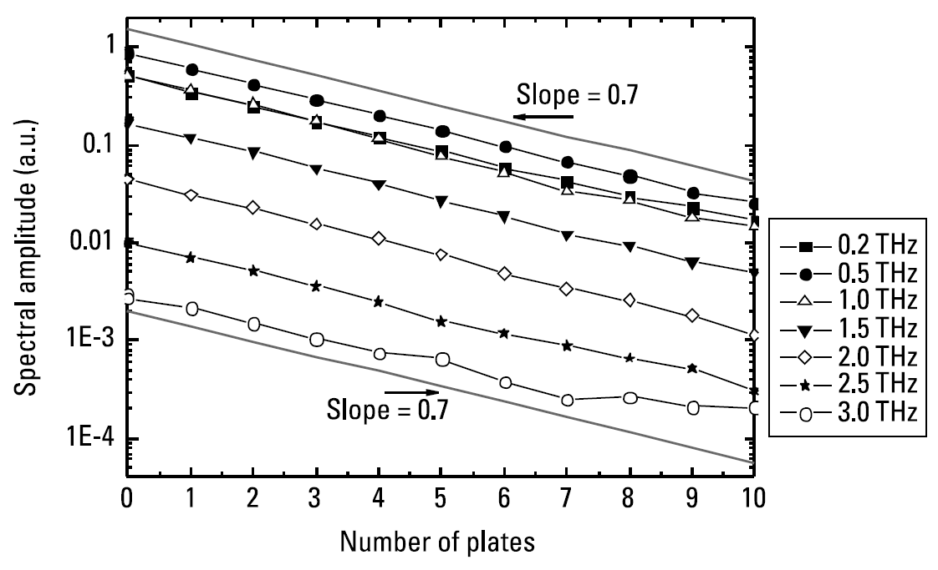
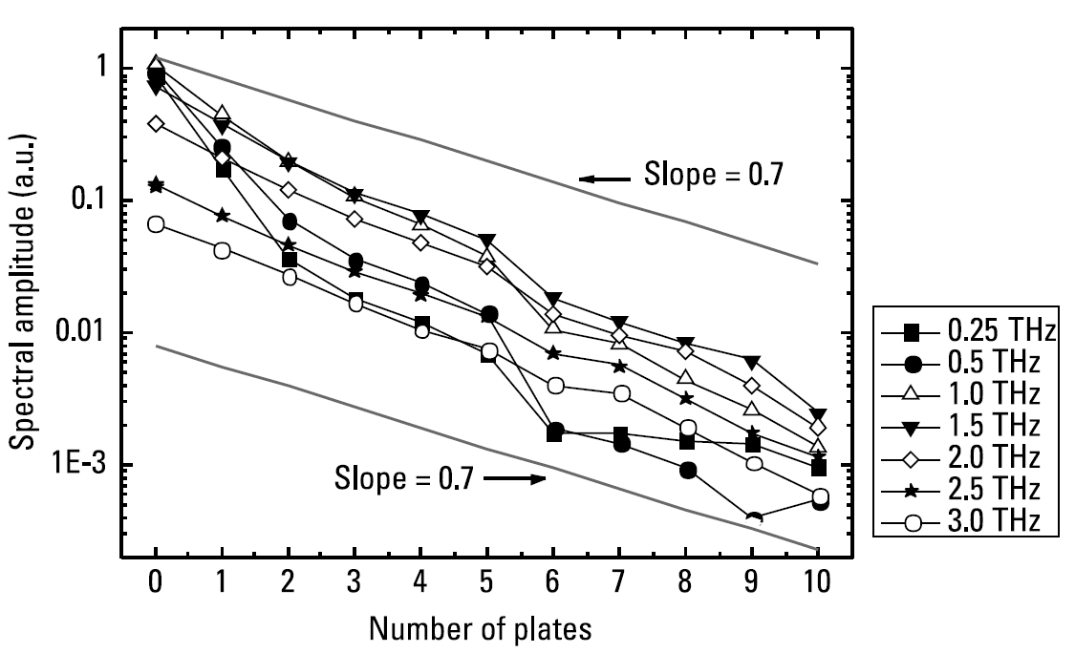
3. Amplitude Linearity Calibration
Verify the linearity of the time-domain signal by plotting the amplitude of the maximum of the peak against the number of silicon plates in the beam path.

Slide 16
Reflection Standards

Slide 17
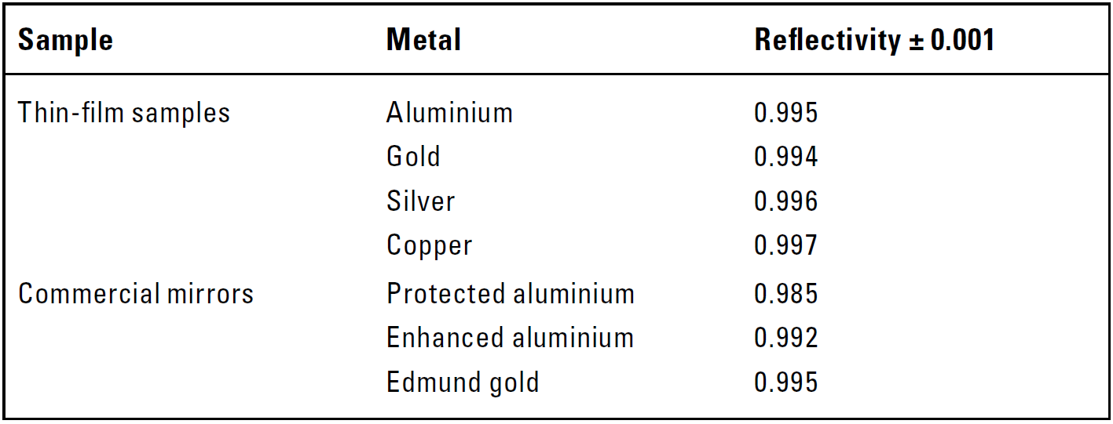
4. Reflection Standards
It is desirable that a reflection standard be totally reflective.
➔ reflectivity = 1

Slide 18
References
Aenchbacher, W., M. Naftaly, and R. Dudley, “Line Strengths and Self-Broadening of Pure Rotational Lines of Carbon Monoxide Measured by Terahertz Time-Domain Spectroscopy,” Applied Optics, Vol. 49, No. 13, 2010, pp. 2490-2496.
Molloy, J. F., et al., “Dispersion Properties of GaS Studied by THz-TDS,” Cryst. Eng. Comm., Vol. 16, 2014, pp. 1995-2000.

